Slide 1
Linked list

Slide 2
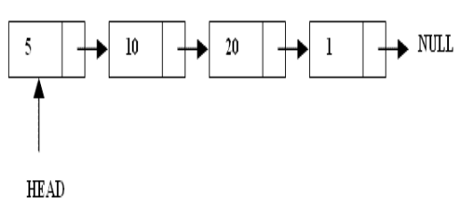
What are Linked Lists?
A linked list is a linear data structure.
Nodes make up linked lists.
Nodes are structures made up of data and a pointer to another node.
Usually the pointer is called next.

Slide 3
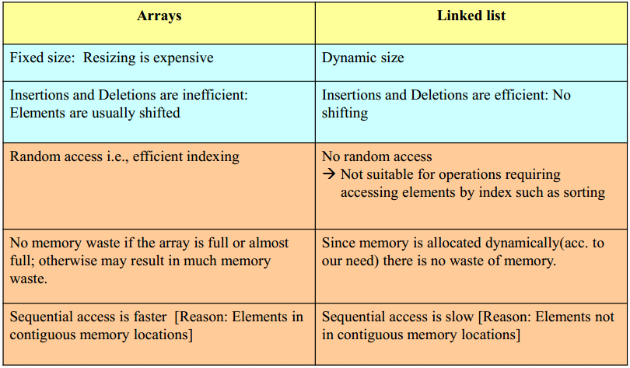
Arrays Vs Linked Lists

Slide 4
Types of lists
There are three basic types of linked list
Singly Linked list
Circular Linked list
Doubly linked list

Slide 5
Singly Linked List
Each node has only one link part
Each link part contains the address of the next node in the list
Link part of the last node contains NULL value which signifies the end of the node

Slide 6

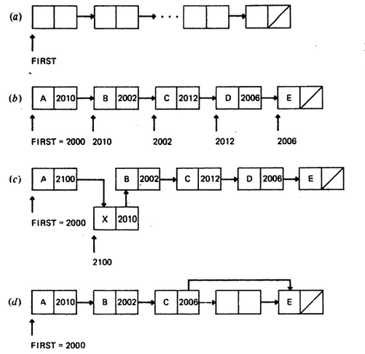

Slide 7
Basic Operations on a list
Creating a List
Inserting an element in a list
Deleting an element from a list
Searching a list

Slide 8
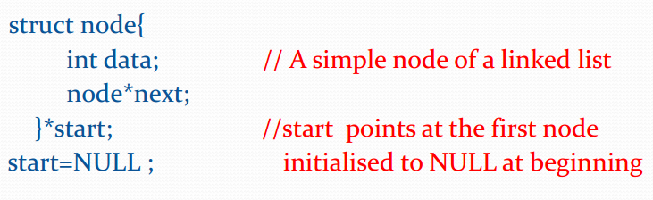
Creating a node

Slide 9
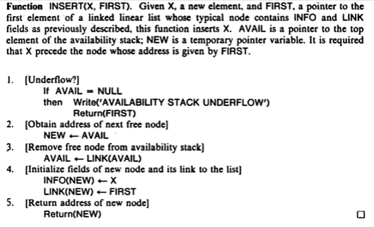
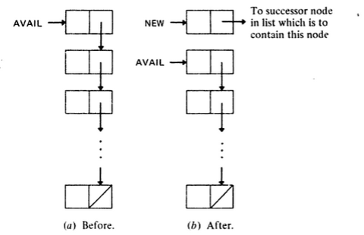

Slide 10
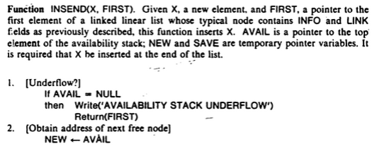
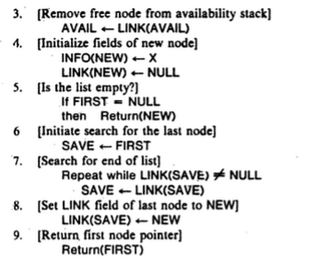

Slide 11
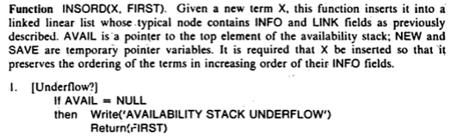
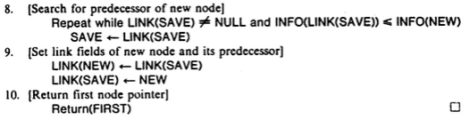
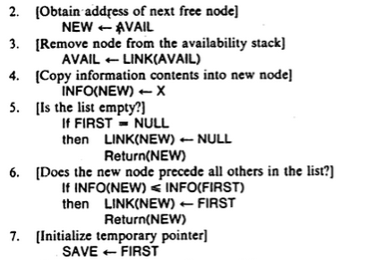

Slide 12
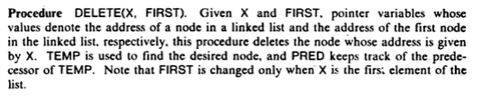
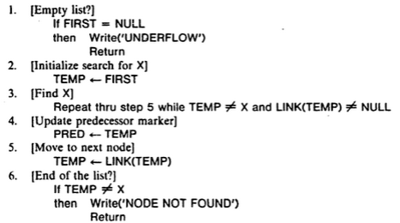
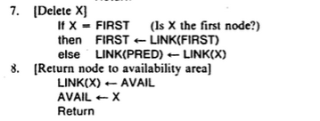

Slide 13
Circular Linked List
In a circular linked list, the last node contains a pointer to the first node of the list.
We can have a circular singly listed list as well as circular doubly linked list.
While traversing a circular linked list, we can begin at any node and traverse the list in any direction forward or backward until we reach the same node where we had started.
Thus, a circular linked list has no beginning and no ending.
FIRST
1
2
3
4
5
6
7

Slide 14
Insert a new node at the beginning of circular linked list
Function INSERTBEG (X, FIRST) : Given X, a new element, and FIRST, a pointer to the first element of a circular linked list whose typical node contains INFO and LINK fields, this functions inserts X. AVAIL is a pointer to the top element of the availability stack, NEW and TEMP are temporary pointer variables. It is required that X precedes the node whose address is given by FIRST.
[Underflow?]
If AVAIL = NULL
then Write (‘STACK UNDERFLOW’)
Return (FIRST)
[Obtain address of next free node]
NEW ← AVAIL
[Remove free node from availability stack]
AVAIL ← LINK (AVAIL)
[Initialize fields of new node]
INFO (NEW) ← X
[Is list empty?]
If FIRST = NULL
Then LINK(NEW) ← NEW
Return (NEW)
[Search for the first node]
TEMP ← FIRST
[Search for the end of the list]
Repeat while LINK(TEMP) != FIRST
TEMP ← LINK(TEMP)
[Set LINK field of new node]
LINK (NEW) ← FIRST

Slide 15
Insert a new node at the beginning of circular linked list
[Set LINK field of last node]
LINK (TEMP) ← NEW
[Return first node pointer]
Return (NEW)
1
7
3
4
2
6
5
FIRST, TEMP
1
7
3
4
2
6
5
FIRST
TEMP
9
1
7
3
4
2
6
5
FIRST

Slide 16
Insert a new node at the end of circular linked list
Function INSERTEND (X, FIRST) : Given X, a new element, and FIRST, a pointer to the first element of a circular linked list whose typical node contains INFO and LINK fields, this functions inserts X. AVAIL is a pointer to the top element of the availability stack, NEW and TEMP are temporary pointer variables. It is required that X be inserted at the end of the list.
[Underflow?]
If AVAIL = NULL
then Write (‘STACK UNDERFLOW’)
Return (FIRST)
[Obtain address of next free node]
NEXT ← AVAIL
[Remove free node from availability stack]
AVAIL ← LINK (AVAIL)
[Initialize fields of new node]
INFO (NEW) ← X
[Is list empty?]
If FIRST = NULL
LINK (NEW) ← NEW
Return (NEW)
[Search for the last node]
TEMP ← FIRST
[Search for the end of the list]
Repeat while LINK(TEMP) != FIRST
TEMP ← LINK(TEMP)
[Set LINK field of new node]
LINK (TEMP) ← NEW
LINK (NEW) ← FIRST
[Return FIRST node pointer]
Return (FIRST)

Slide 17
Delete a node from the beginning of circular linked list
Procedure DELETEBEG (FIRST) : Given FIRST, a pointer to the first element of a circular linked list whose typical node contains INFO and LINK fields, this procedure deletes the node from the beginning of the circular linked list. TEMP is used to find the desired node.
[Empty list?]
If FIRST = NULL
then Write (‘UNDERFLOW’)
Return
[Initialize search for first node]
TEMP ← FIRST
[Search for the end of list]
Repeat while LINK (TEMP) != FIRST
TEMP ← LINK (TEMP)
[Delete the first node]
LINK (TEMP) ← LINK (FIRST)
[Make next node to be first]
FIRST ← LINK ( TEMP)
Return

Slide 18
Delete a node from the end of circular linked list
Procedure DELETEEND (FIRST) : Given FIRST, a pointer to the first element of a circular linked list whose typical node contains INFO and LINK fields, this procedure deletes the node from the end of the circular linked list. TEMP is used to find the desired node. PRED keeps track of predecessor of TEMP.
[Empty list?]
If FIRST = NULL
then Write (‘UNDERFLOW’)
Return
[Initialize search for first node]
TEMP ← FIRST
[Find last node]
Repeat thru Step 5 while LINK (TEMP) != FIRST
[Update predecessor marker]
PRED ← TEMP
[Move to next node]
TEMP ← LINK ( TEMP)
[Delete last node]
LINK (PRED) ← FIRST
[Return node to availability stack]
LINK (TEMP) ← AVAIL
AVAIL ← TEMP
Return

Slide 19
THANK YOU!!

